Slide 1
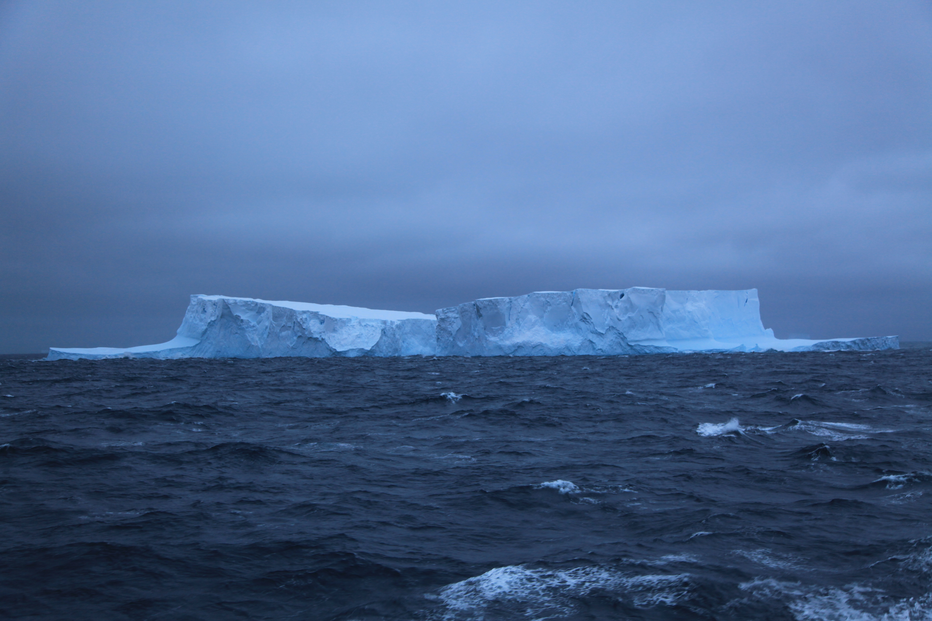
Dynamic Planet 2020 /Oceanography
JHU Science Olympiad Workshop
Anand Gnanadesikan

Slide 2
General slide on study events
Read the rules
Build a binder
  For each concept in the list of concepts, write down a paragraph or so of information/include pictures.
  You may, or may not be allowed to use the binder in the test… but the process of building it will give you a huge amount of information.
  Do not simply download and print out material.
Use the binder to generate tests for themselves.
Coaches major role- accountability, helping understand concepts.

Slide 3
Some possible resources
https://www.reefimages.com/oceansci.php
https://rwu.pressbooks.pub/webboceanography/front-matter/preface/

Slide 4
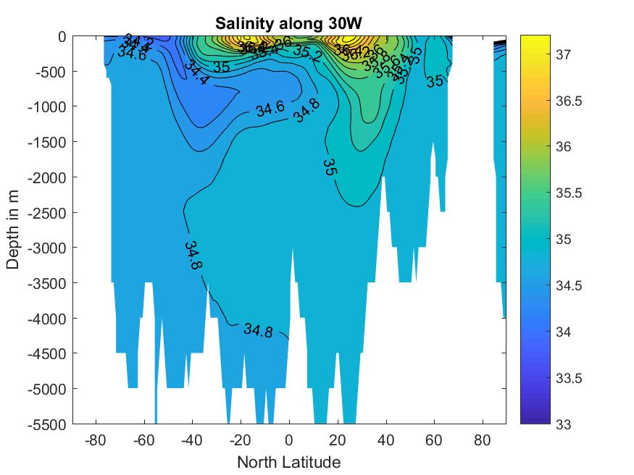
Key concept- salinity and what we can learn from it
Originally measured in terms of solute concentration.
Now is measured in terms of ability of seawater to conduct electricity.
Affects density (salty water is denser)
What does a profile at 20S look like?

Slide 5
What do we see in the Atlantic
High values in the mid-latitudes
Low values emanating from Southern ocean into deep.
High values penetrating from North Atlantic into deep.

Slide 6
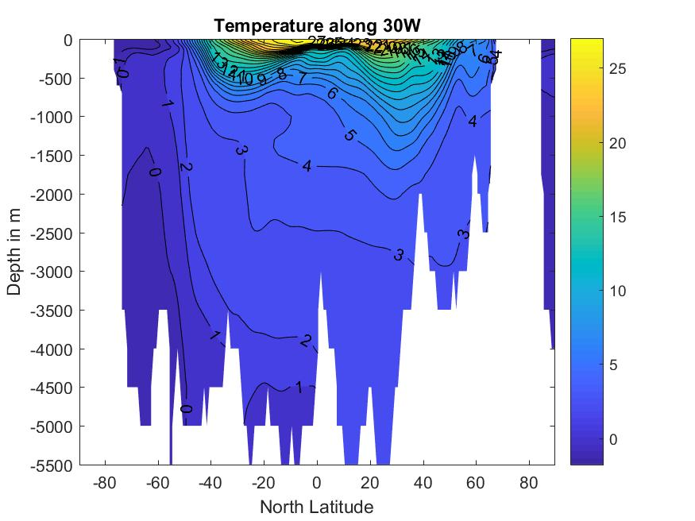
Temperature in Atlantic
Warm waters only found very close to surface- waters at depth are cold.
These waters “outcrop” at high latitudes- most of the ocean is “ventilated” i.e. waters are supplied from high latitudes.
Different properties of water coming from the north and south (slightly warmer from north, cooler from south).

Slide 7
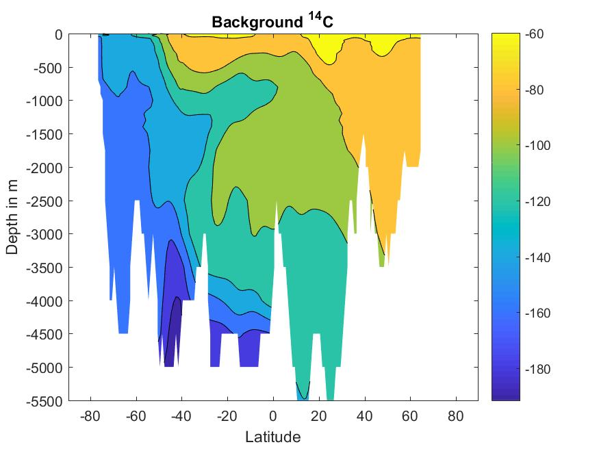
Radiocarbon in Atlantic
Radiocarbon is produced in stratosphere by nitrogen interacting with galactic cosmic rays.
Enters ocean relatively slow and decays.
Units are fraction that has decayed in parts per thousand (1 per mille ~8 years)
What do these three tracers put together suggest about pathways of flow?

Slide 8
Pathways of flow

Slide 9

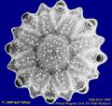

One reason why the overturning matters: The challenge for ocean plants
Biological activity takes up these nutrients
Shallow sunlit
euphotic zone
Mixing and
upwelling bring nutrients to the surface.
High nutrient
ocean interior
Sinking fluxes export nutrients back to depth

Slide 10
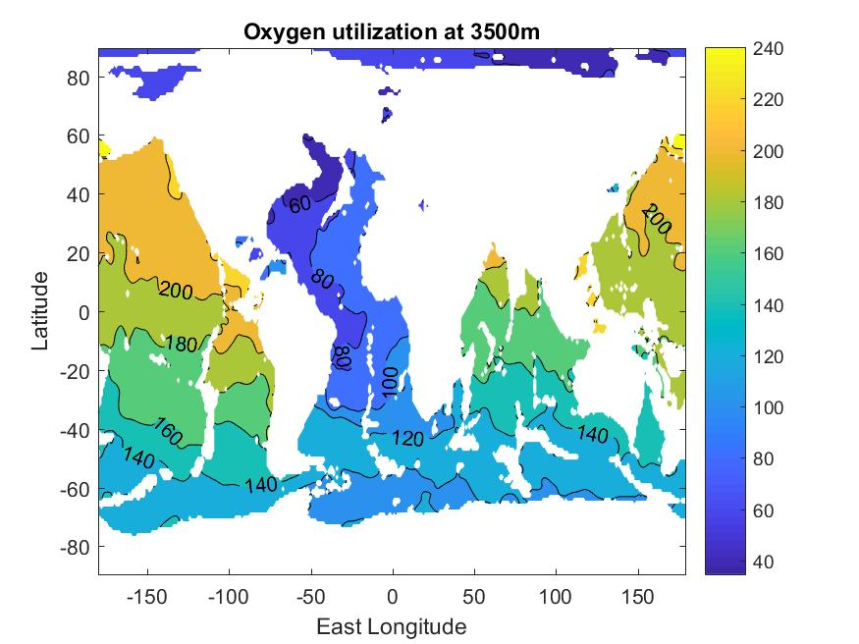
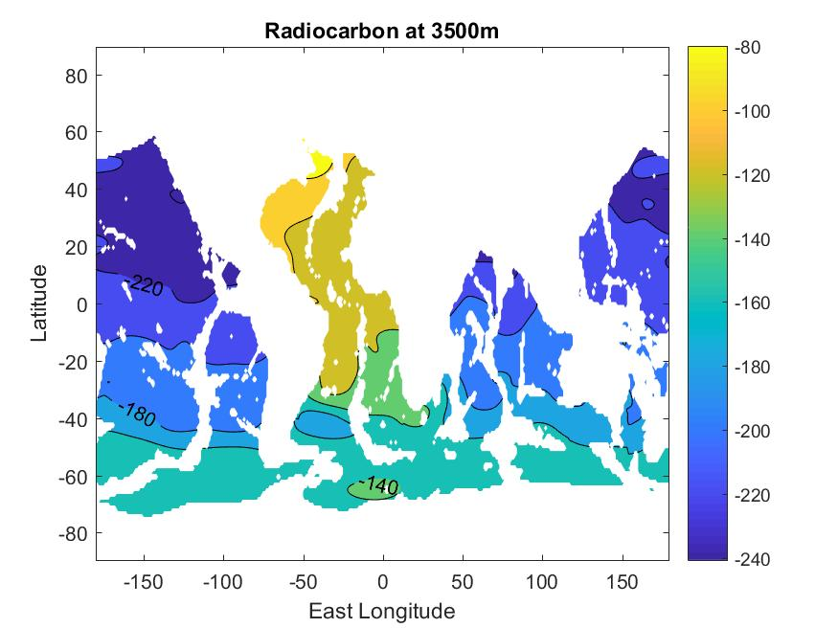
Oxygen and radiocarbon at depth in the ocean

Slide 11
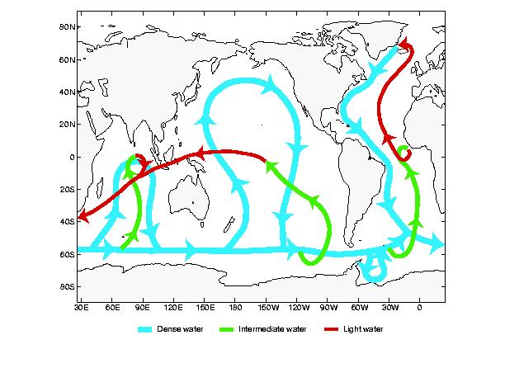
Putting this together

Slide 12
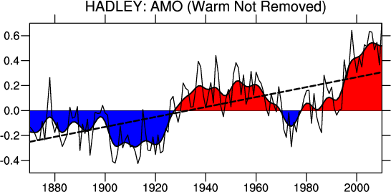
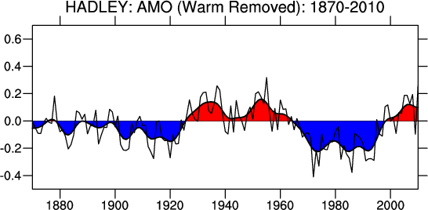
Variability in North Atlantic temperature- may be associated with changes in overturning…

Slide 13
Greenland cod catch
Stein, J. Northw. Atl. Fish. Sci., 2007
Is this merely coincidental?

